Slide 1



PARALLEL PROGRAMMING
N-BODY PROBLEM
Anas & Shahin

Slide 2




Chapter 1 : Introduction
WHAT IS THE N-BODY PROBLEM
DEFINITION

Slide 3

N-Body
What’s it all about?
Refers to the challenge in predicting the long-term motion of a system containing three or more gravitating objects, such as planets in a solar system.

Slide 4


The Importance of Individuality
A Brief Introduction
Gravitational interactions at scale are fundamental to understanding the structure, evolution, and dynamics of the universe. They are described by the principles of Newtonian gravity and, on larger cosmological scales, by the theory of general relativity
Notes:
The N-body problem refers to the challenge in predicting the long-term motion of a system containing three or more gravitating objects, such as planets in a solar system. While equations can accurately describe the gravitational forces between two bodies (thanks to Newton's laws), extending this to systems with more bodies introduces complexity. The problem becomes analytically unsolvable due to the increasing number of unknown variables, leading to chaotic behavior where small differences in initial conditions result in vastly different outcomes over time. The restricted three-body problem is a simplified approach, treating one body as negligible, and advancements in computer simulations help approximate solutions for more accurate predictions.

Slide 5


Mathematical Solution
The Euler Method
The Euler method is a numerical technique used to estimate the solution to ordinary differential equations (ODEs), and it can be applied to approximate the motion of celestial bodies in an N-body system. Here's a simplified explanation of how the Euler method can be used for the N-body problem.

Slide 6

Chapter 2 : computing
THE COMPUTATIONAL IMPLEMENTATION “SEQUENTIAL CODE”

Slide 7
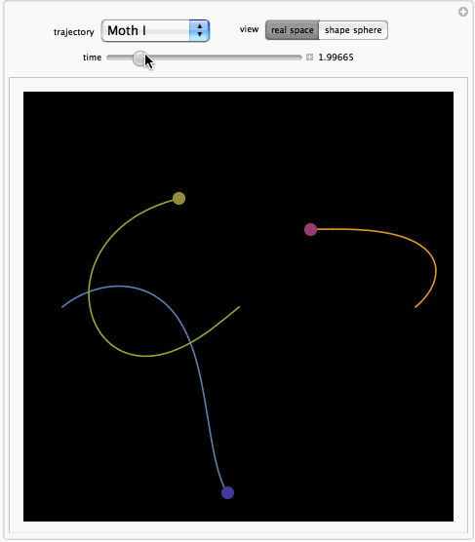
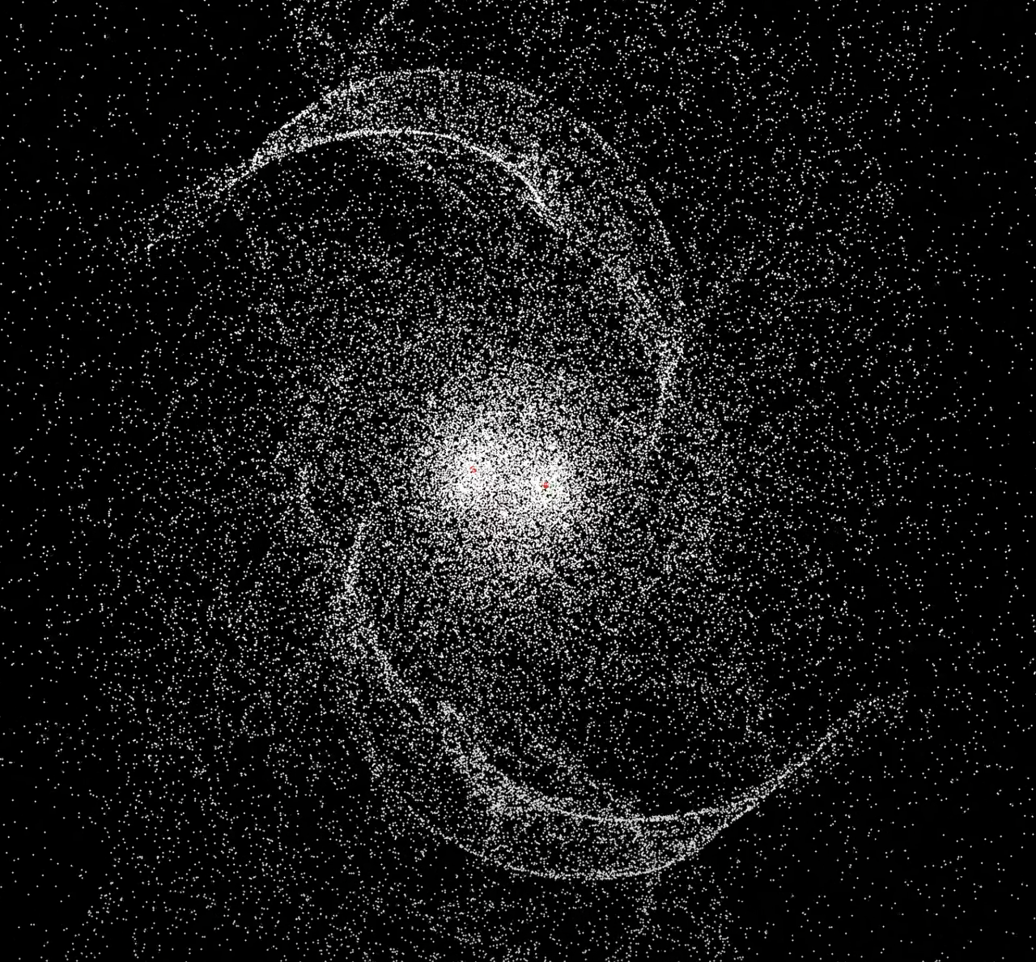

Slide 8
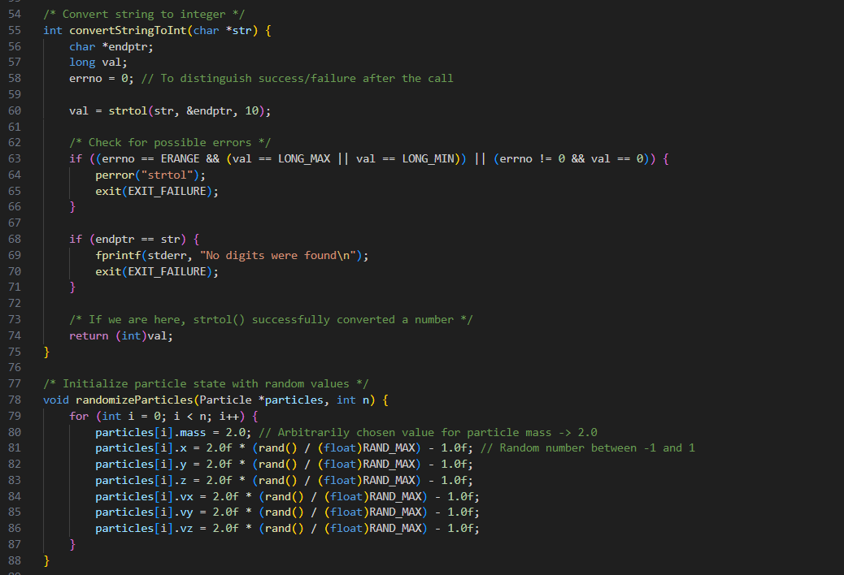
Particle Production
This program generates a specified number of particles with random properties, stores the particle data in a binary file, and measures the elapsed time for this process.

Slide 9
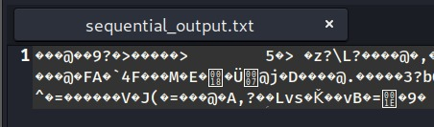

Slide 10
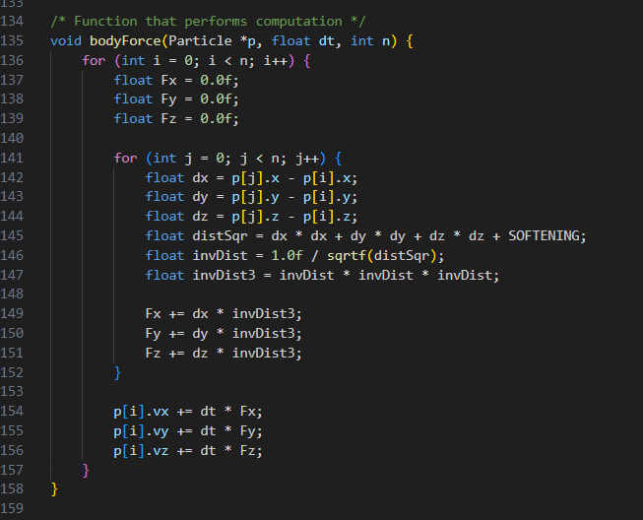
Main Sequential:
This particular n-body problem simulation has been expertly adapted to be compatible with the Linux operating environment. The n-body problem, which is a classic issue in physics, requires careful and precise simulation, and this particular example provides a robust model for understanding this complex dynamical system

Slide 11

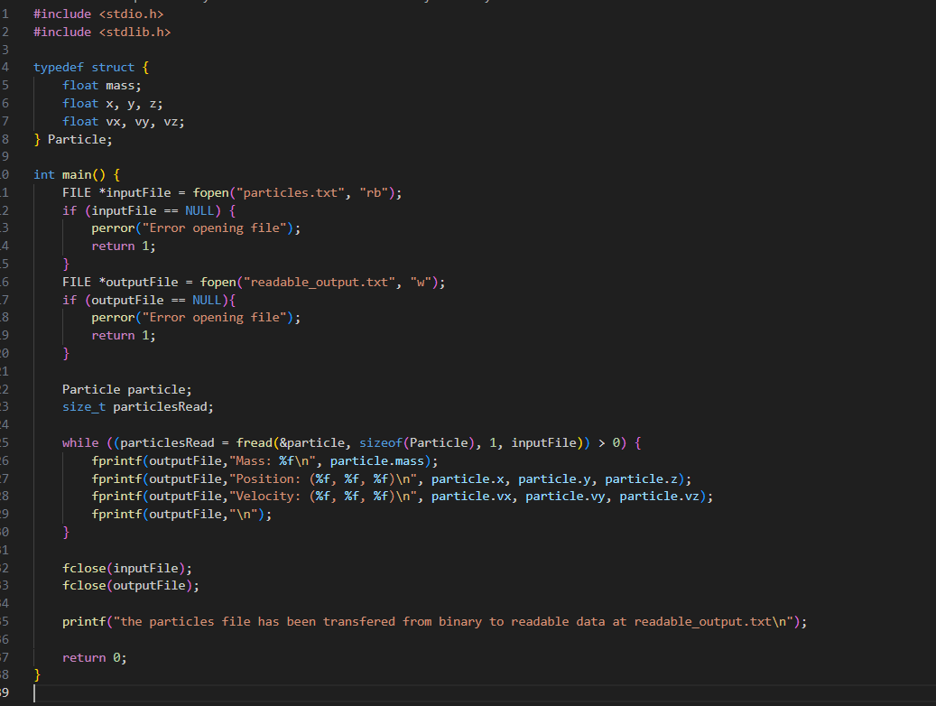
Read function:
The following text pertains to a read file that is specifically designed to decode the binary output that is generated by the prior code. This decoded output is then converted into results that are easily readable and understandable, allowing users to make sense of the processed data with greater ease. The primary purpose of this read file is to bridge the gap between complex binary code and user-friendly text, thereby ensuring that the key findings and outcomes of the code are accessible to all.

Slide 12

Chapter 3: Paralization
THE ENHANCEMENT THROUGH CODE PARALIZATION

Slide 13

PARALYZATION
OPEN MP
PTHREADS
Shared-memory parallelism by employing multiple threads to concurrently compute interactions. Well-suited for multi-core processors.
A threading library for parallelizing tasks in a multi-threaded environment. It can be utilized to parallelize computations within a shared-memory system.
MESSAGE PASSING INTERFACE
CUDA C
Enables parallel computing in distributed-memory environments by allowing communication between separate processes. MPI is suitable for large-scale clusters .
Tailored for NVIDIA GPUs, CUDA offloads parallelable tasks to the GPU, taking advantage of its parallel processing capabilities and accelerating simulations.

Slide 14
A Deeper Look
Our Result and analysis
DATA

Slide 15
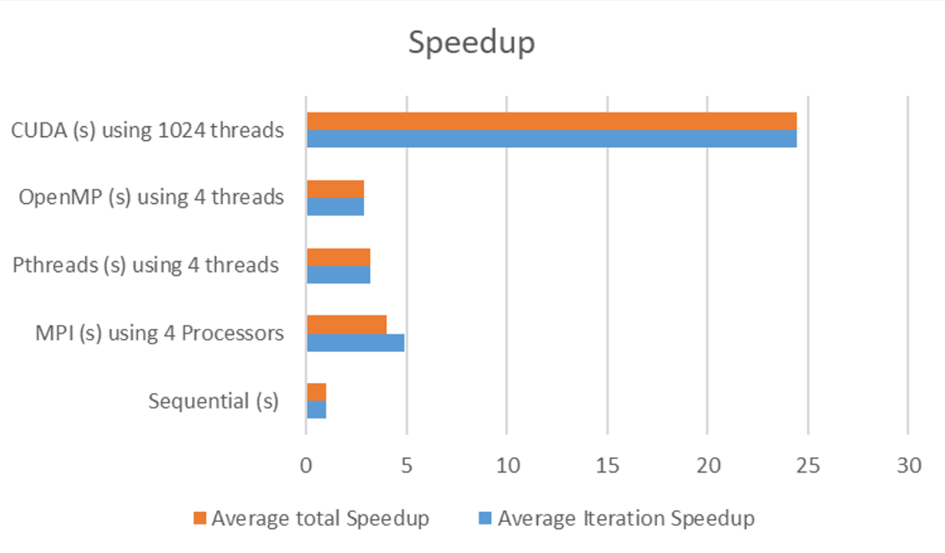

Slide 16
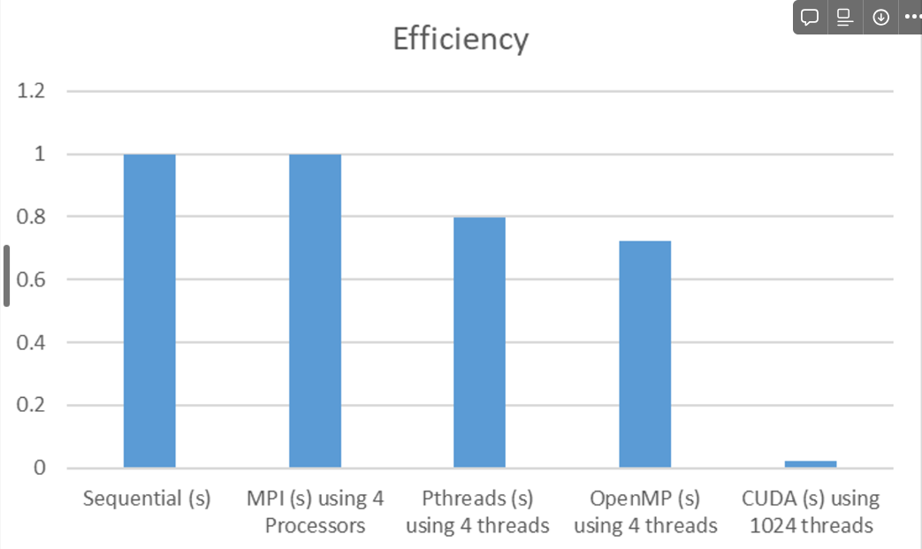

Slide 17

RECOMMENDATION
Different parallelization
Optimizing
Techniques can be more suitable depending on the nature of the hardware and the specific requirements of the task.
optimizing and fine-tuning parameters within each parallelization approach can often lead to further performance gains.
Other Factors
The Mediums Available
consider factors like implementation complexity, potential for future scalability, and the type of parallel architecture available
Presentations are communication tools that can be used as lectures.

Slide 18
Bibliography
ON THE N-BODY PROBLEM IN R4
https://royalsocietypublishing.org/doi/10.1098/rsta.2019.0018
SOLVING AND ANIMATING THREE-BODY PROBLEM
https://www.britannica.com/science/celestial-mechanics-physics/Tidal-evolution
SOLVING THE QUANTUM MANY-BODY PROBLEM WITH ARTIFICIAL NEURAL NETWORKS
https://www.science.org/doi/full/10.1126/science.aag2302

Slide 19
NAMES
EMAIL ADDRESS
ID
Mohammad Shahin
Anas Al Baqri
Mohammad.Shahin01@lau.edu
202105493
Thank you
Have any questions or suggestions?

